Slide 1

Mount Pleasant Primary School
Welcome Meeting
YearS 4, 5 and 6 2026-27

Slide 2

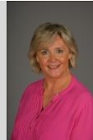
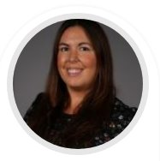
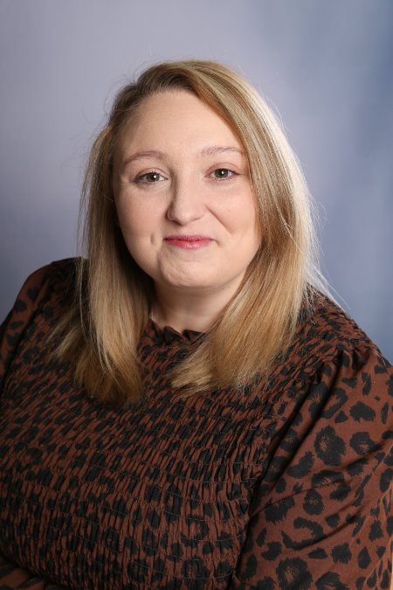
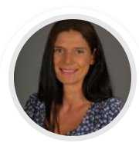
Meet the Team
SLT
Mrs Grinsell Headteacher Miss Williams Deputy Headteacher
Ms Priest Pastoral Lead Mrs Stokes Assistant Headteacher

Slide 3
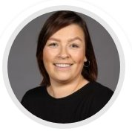
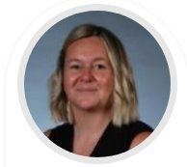
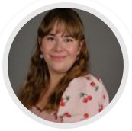
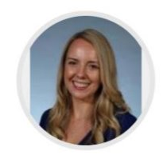
Meet the Team
Year 6
Miss Morgan Miss Stevenson
Learning Support Assistants:
Mrs Overfield Miss Ware
Miss Fletcher-Jones Mrs Phillips

Slide 4
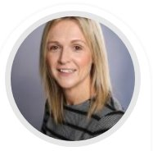
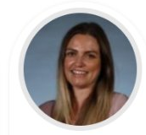
Meet the Team
Year 5
Mrs Clarke MrsArcher
Learning Support Assistant:
Miss Ware
Miss Morgan

Slide 5
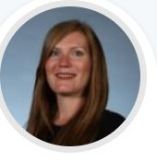
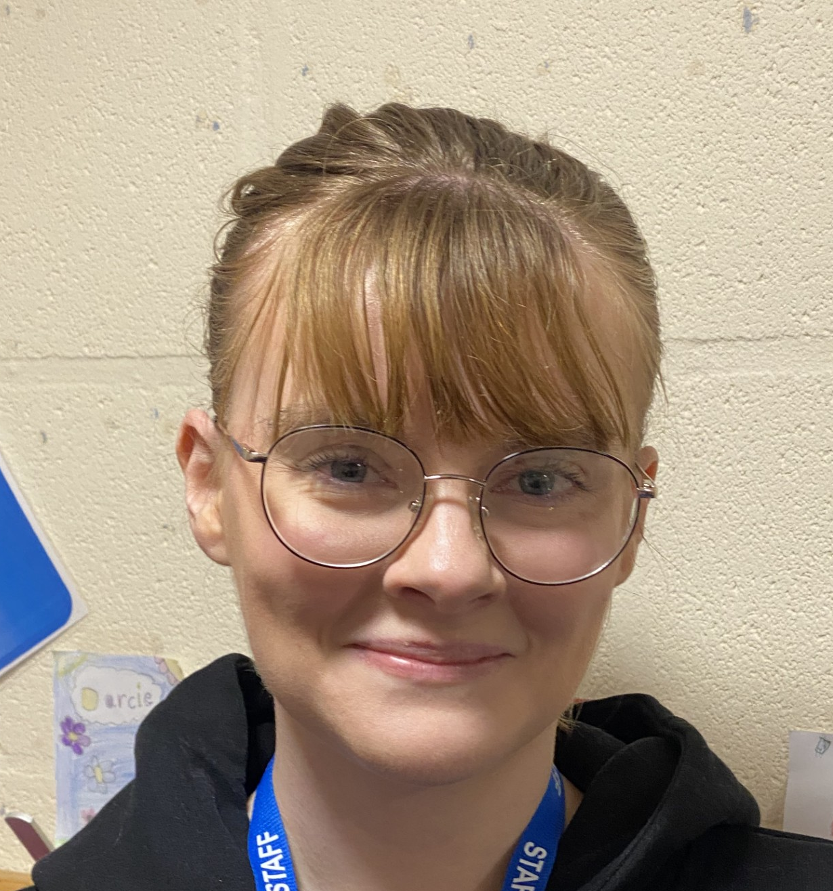
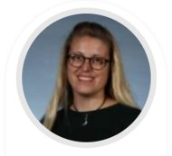
Meet the Team
Year 4
Mrs Pickford Miss Simpson
Mrs Willetts

Slide 6
Attendance MATTERS
Excellent attendance at school allows a child to have the best possible start in life.
Illness
It can be tricky deciding whether to keep your child off school when they are unwell. Most illnesses are very mild, like a minor headache or a slight cold. If you decide to keep your child at home, it’s important to phone the school, or complete our online absence form before 9am to let us know why they will be absent. Parents need to call school every day of a child’s absence.
What should I do if my child is anxious or worried about going to school?
Sometimes, children and young people are anxious or worried about going to school. This could be because of reasons inside and outside school. You may feel, under these circumstances, it is best to allow your child to miss school. This will not help find a solution. If your child is worried about going to school, contact us to discuss the concern so it can be resolved.
Routine medical and dental appointments
Wherever possible, make medical and dental appointments after school or in school holidays.
What about taking my child out of school to go on holiday?
We will not authorise holidays taken during term time, unless there is an agreed exceptional circumstance. Should you wish to take your child out of school, then please complete a form which you can find in the waiting area.

Slide 7
Important: Attendance Notices
Penalty notices issued for offences are charged at a rate of £160 per parent per child. This can be paid at £80 if paid within 21 days.
Any second penalty notice issued to the same parent for the same child within a rolling 3-year period will be issued at the rate of £160 to be paid within 28 days with no option for a discounted rate.
The threshold at which a penalty notice must be considered is set at 10 sessions (equivalent to 5 days) of unauthorised absence within a rolling 10-school week period. This may include absences as a result of arriving late after the register closes at 9:15 am. The 10 school weeks may span different terms or school years.
A maximum of 2 penalty notices may be issued to a parent for the same child within a rolling 3-year period, so at the 3rd (or subsequent) offence(s) another course of action will need to be considered (such as prosecution).

Slide 8

Communication
It is good to talk!
Picking Up
Make an appointment via the office
Speak to the right person – class teachers first ☺
Keeping in touch with you
Newsletters
Texts via School Spider
Parents' evenings
Website
Email

Slide 9

SEND and Inclusion
Inclusion is at the heart of what we do. We make reasonable adjustments and provide tailored support so that every child can access learning, participate fully and feel that they belong.
Our approach is as follows:
Inclusive classrooms for all children
Adaptations made to teaching and learning approaches
Targeted support
Strong partnerships with families
Regular review and responsive provision
A whole-school commitment to belonging, progress and wellbeing
Currently, Mrs Grinsell is leading SEND in school with support from the SEND and Inclusion team. If you have any queries or concerns regarding additional needs, please email our new SEND inbox which will be checked every 2/3 days.
send@mount.dudley.sch.uk

Slide 10
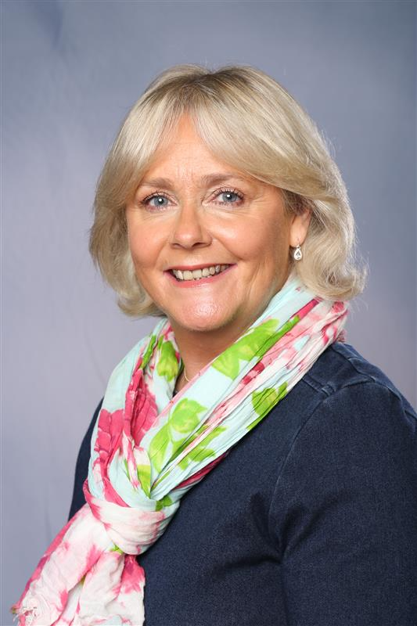

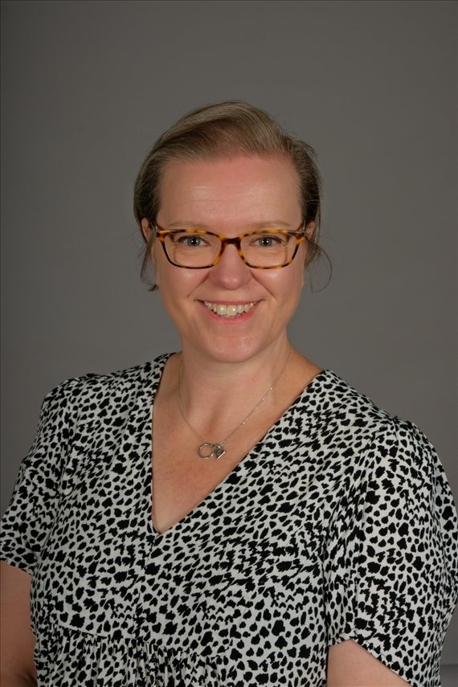
Safeguarding is at the heart of all we do
Safeguarding is everyone’s responsibility.
If you are concerned about a child or young person, please see a member of our Safeguarding Team or report it to Children’s Services 0300 555 0050 (9am – 5pm) or 0300 555 8574 (out of office hours) In an emergency dial 999
Mrs Grinsell Ms Priest Mrs Jones
Designated Safeguarding Lead Deputy Safeguarding Lead Deputy Safeguarding Lead

Slide 11
 | Year 4,5,6 Learning Beyond the Classroom 2026-2027
 | Visitors in | Visits in the locality | Visits outside the locality | After school clubs
Autumn | Y4 Saxons & Vikings workshop Y4 Fire Service – SPARKS Y5 Road Safety Talk – Walking to School Y5 and Y6 Early Help Policing – Anti Social Behaviour Y6 Road Safety Talk – Transition to Secondary School Y6 Class Assembly – Remembrance Service | Y4, Y5, Y6 Christchurch – Christmas Carol Concert Y6 Carol Concert – Stourbridge Town Hall | Y5 Stratford/Tudor World £25 Y5 Frank Chapman Centre, Bewdley – 3days/2 nights £220.00 Possibility of 1 day Astley Burf (price TBC) OR 2days/1 night Astley Burf. £120.00 Y6 Frank Chapman Centre, Bewdley – 2 nights, 3 days £220.00 | Booster Y6 Football Y5, Y6 Choir – Young Voices Y4, Y5, Y6 Y4 Cricket Y4 Tennis Y4 and Y5 Jewellery Club
Spring | Y5 Class assembly Y4 Class assembly Y5 and Y6 Early Help Policing – Online Safety Y5 and Y6 Mental Health and Wellbeing workshop - Phase Trust - Y6 Puberty – My Mate Fancies You Loudmouth Theatre Company | Y4, Y5, Y6 Library Y4 Forest School Y4 Dudley Canal – Delph Locks | Y6 Staffordshire Regiment Museum and the National memorial Arboretum - £20 | Booster Y6 Gymnastics Y4, Y5, Y6 Tennis Netball Y5, Y6 Y4 & Y5 STEM Club Y4 Football
Summer | Y5 First Aid Classes for Children Y5 Greek Day £9 Y6 Puberty/RSE Talks – Physical, emotional changes and Sex education – School Nurse Y6 Leavers’ Assembly Y6 End of Year Production | Y5 Forest School Y6 Netherton – Titanic Anchor Cinema £12 Forest School Park Picnic and Leavers’ Celebration/ Leavers’ Party £5 | Y4 Severn Valley Country Park £20 | Drama Club Y5, Y6 Computing Club Y5 Y6 Fun Fitness Y4, Y5, Y6 Gardening Y5, Y6 Film Club Y4, Y5

Slide 12


Slide 13
Thank you for coming, we look forward to working with you all.

