Slide 1

Mount Pleasant Primary School
Welcome Meeting
YearS 1, 2 and 3 2026-27

Slide 2
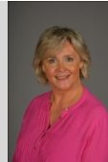
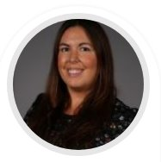
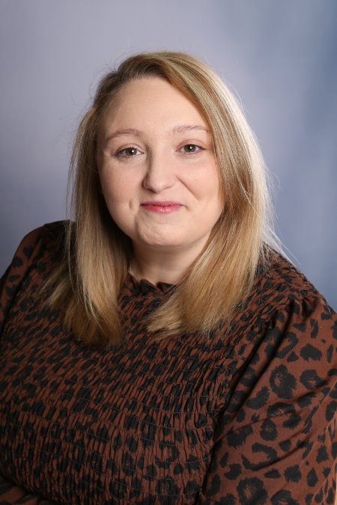
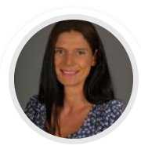
Meet the Team
SLT
Mrs Grinsell Headteacher Miss Williams Deputy Headteacher
Ms Priest Pastoral Lead Mrs Stokes Assistant Headteacher

Slide 3
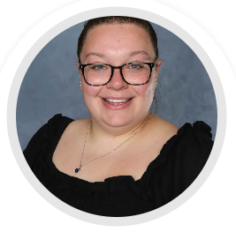
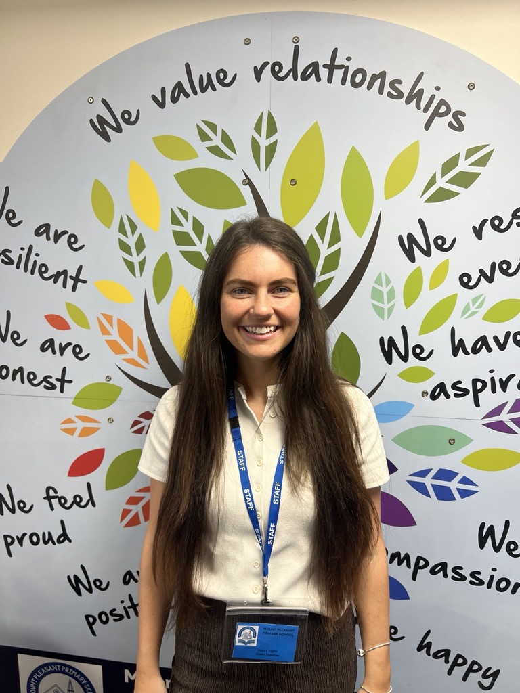
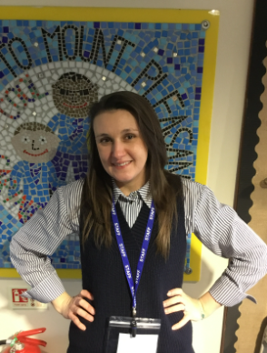
Meet the Year 3 Team.
Miss Norgrove Miss Tighe
Mrs Bott

Slide 4
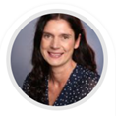
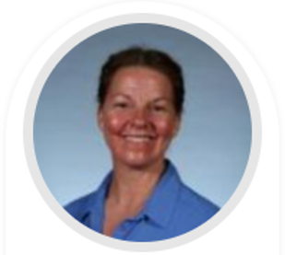
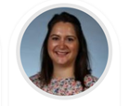
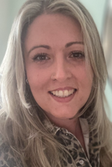
Meet the Year 2 Team.
Mrs Stokes Mrs Walton
Mrs Smith Miss Nicholls

Slide 5
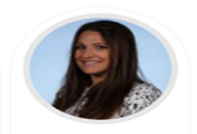
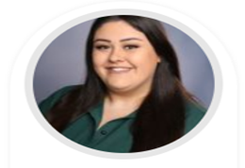
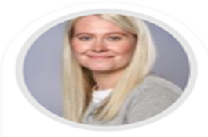
Meet the Year 1 Team.
Mrs Poole Miss Cartwright
Mrs Hammond

Slide 6
Attendance MATTERS
Excellent attendance at school allows a child to have the best possible start in life.
Illness
It can be tricky deciding whether to keep your child off school when they are unwell. Most illnesses are very mild, like a minor headache or a slight cold. If you decide to keep your child at home, it’s important to phone the school, or complete our online absence form before 9am to let us know why they will be absent. Parents need to call school every day of a child’s absence.
What should I do if my child is anxious or worried about going to school?
Sometimes, children and young people are anxious or worried about going to school. This could be because of reasons inside and outside school. You may feel, under these circumstances, it is best to allow your child to miss school. This will not help find a solution. If your child is worried about going to school, contact us to discuss the concern so it can be resolved.
Routine medical and dental appointments
Wherever possible, make medical and dental appointments after school or in school holidays.
What about taking my child out of school to go on holiday?
We will not authorise holidays taken during term time, unless there is an agreed exceptional circumstance. Should you wish to take your child out of school, then please complete a form which you can find in the waiting area.

Slide 7
Important: Attendance Notices
Penalty notices issued for offences are charged at a rate of £160 per parent per child. This can be paid at £80 if paid within 21 days.
Any second penalty notice issued to the same parent for the same child within a rolling 3-year period will be issued at the rate of £160 to be paid within 28 days with no option for a discounted rate.
The threshold at which a penalty notice must be considered is set at 10 sessions (equivalent to 5 days) of unauthorised absence within a rolling 10-school week period. This may include absences as a result of arriving late after the register closes at 9:15 am. The 10 school weeks may span different terms or school years.
A maximum of 2 penalty notices may be issued to a parent for the same child within a rolling 3-year period, so at the 3rd (or subsequent) offence(s) another course of action will need to be considered (such as prosecution).

Slide 8

Communication
It is good to talk!
Picking Up
Make an appointment via the office
Speak to the right person – class teachers first ☺
Our messages to you
Newsletters
Texts via School Spider
Parents' evenings
Website
Email

Slide 9
 | Years 1,2,3 Learning Beyond the Classroom 2026-2027
 | Visitors in | Visits in the locality | Visits outside the locality | After school clubs
Autumn | Pantomime – 1,2,3 Y1 Emergency Services – what to do in an emergency Y1 Dental health - Dentist Visit Y2 Representative from Mary Stevens Hospice Y2 School Nurse | Y1 Church – Christmas RE focus Y2 Mary Stevens Park Stourbridge Park Haden Hill House Map making around school grounds Forest School Church – Christmas RE focus Y3 Christ Church – Carol Concert Y3 Christ Church – RE – Christmas Y3 Saltwells Geography fieldwork Forest school |  | Build & Make Club Y1 & Y2 Cricket Y3 Felting Club Y2 & Y3 Tennis Y3
Spring | Y1 Road Safety Visitors – Dudley MBC Y1Handwashing – School Nurse RNLI – Water Safety – water safety workshops Y2 NSPCC Speak out, Stay safe Y2 Class Assembly Y3 Mental Health and Wellbeing Workshop - Phase Trust | Y2 Church – Easter Y2 Stevens Park, Quarry Bank Y3 Saltwells – Claypits (Forest School) Library – 1,2,3 | Y1 Hartlebury Castle & Toy Museum £22.50 | Gymnastics Y1, Y2 & Y3 Football Y3 STEM Club Y3 Little Voices Y1 & Y2 Art Y1 & Y2
Summer | Y1 Fire Safety Y1 Class Assembly Y2 Road Safety Visitors – Dudley MBC Y3 First Aid Classes for Children Y3 Class Assembly | Library – 1,2,3 Y1 - Map making around our school area Forest School-Shade and Shelter Y2 - Litter Picking Y2 -Stevens Park, Quarry Bank | Wroxetter Roman City £20 https://www.english-heritage.org.uk/visit/places/wroxeter-roman-city/ | Football Y1, Y2 Multisports Y1,Y2, Y3 Tennis Y1, Y2 Cheerleading Y1 Y2

Slide 10

SEND and Inclusion
Inclusion is at the heart of what we do. We make reasonable adjustments and provide tailored support so that every child can access learning, participate fully and feel that they belong.
Our approach is as follows:
Inclusive classrooms for all children
Adaptations made to teaching and learning approaches
Targeted support
Strong partnerships with families
Regular review and responsive provision
A whole-school commitment to belonging, progress and wellbeing
Currently, Mrs Grinsell is leading SEND in school with support from the SEND and Inclusion team. If you have any queries or concerns regarding additional needs, please email our new SEND inbox which will be checked every 2/3 days.
send@mount.dudley.sch.uk

Slide 11
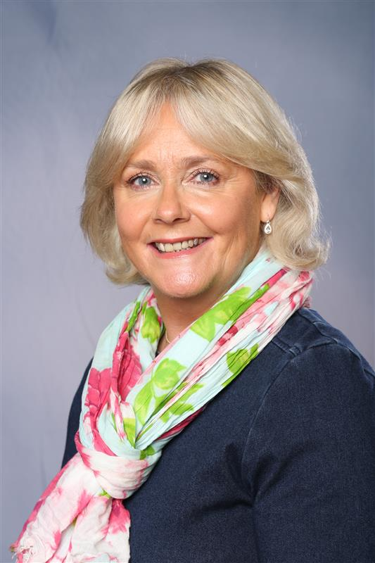

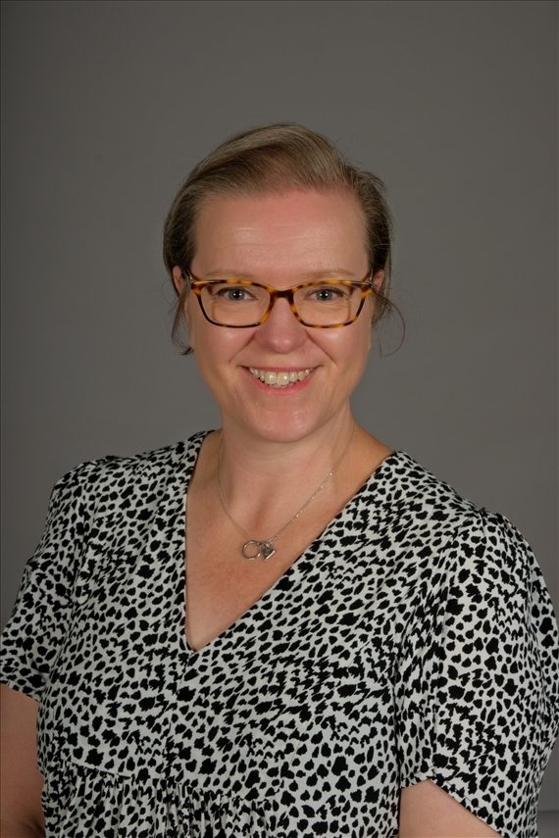
Safeguarding is at the heart of all we do
Safeguarding is everyone’s responsibility.
If you are concerned about a child or young person, please see a member of our Safeguarding Team or report it to Children’s Services 0300 555 0050 (9am – 5pm) or 0300 555 8574 (out of office hours) In an emergency dial 999
Mrs Grinsell Ms Priest Mrs Jones
Designated Safeguarding Lead Deputy Safeguarding Lead Deputy Safeguarding Lead

Slide 12


Slide 13
Thank you for coming, we look forward to working with you all.

