Slide 1

Mount Pleasant Primary School
Welcome Meeting
Reception 2026 - 2027

Slide 2
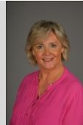
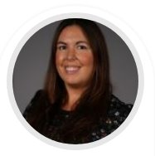
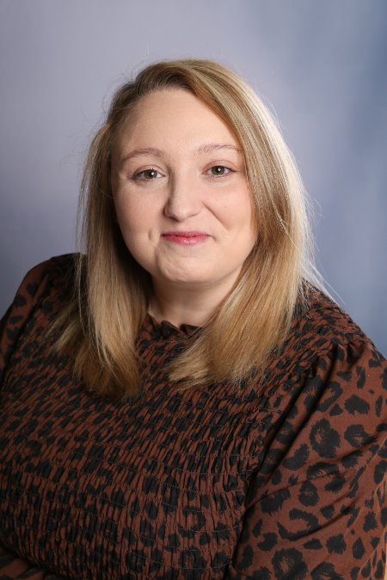
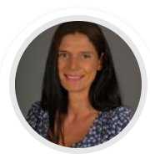
Meet the Team
SLT
Mrs Grinsell Headteacher Miss Williams Deputy Headteacher
Ms Priest Pastoral Lead Mrs Stokes Assistant Headteacher

Slide 3
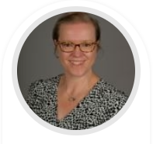
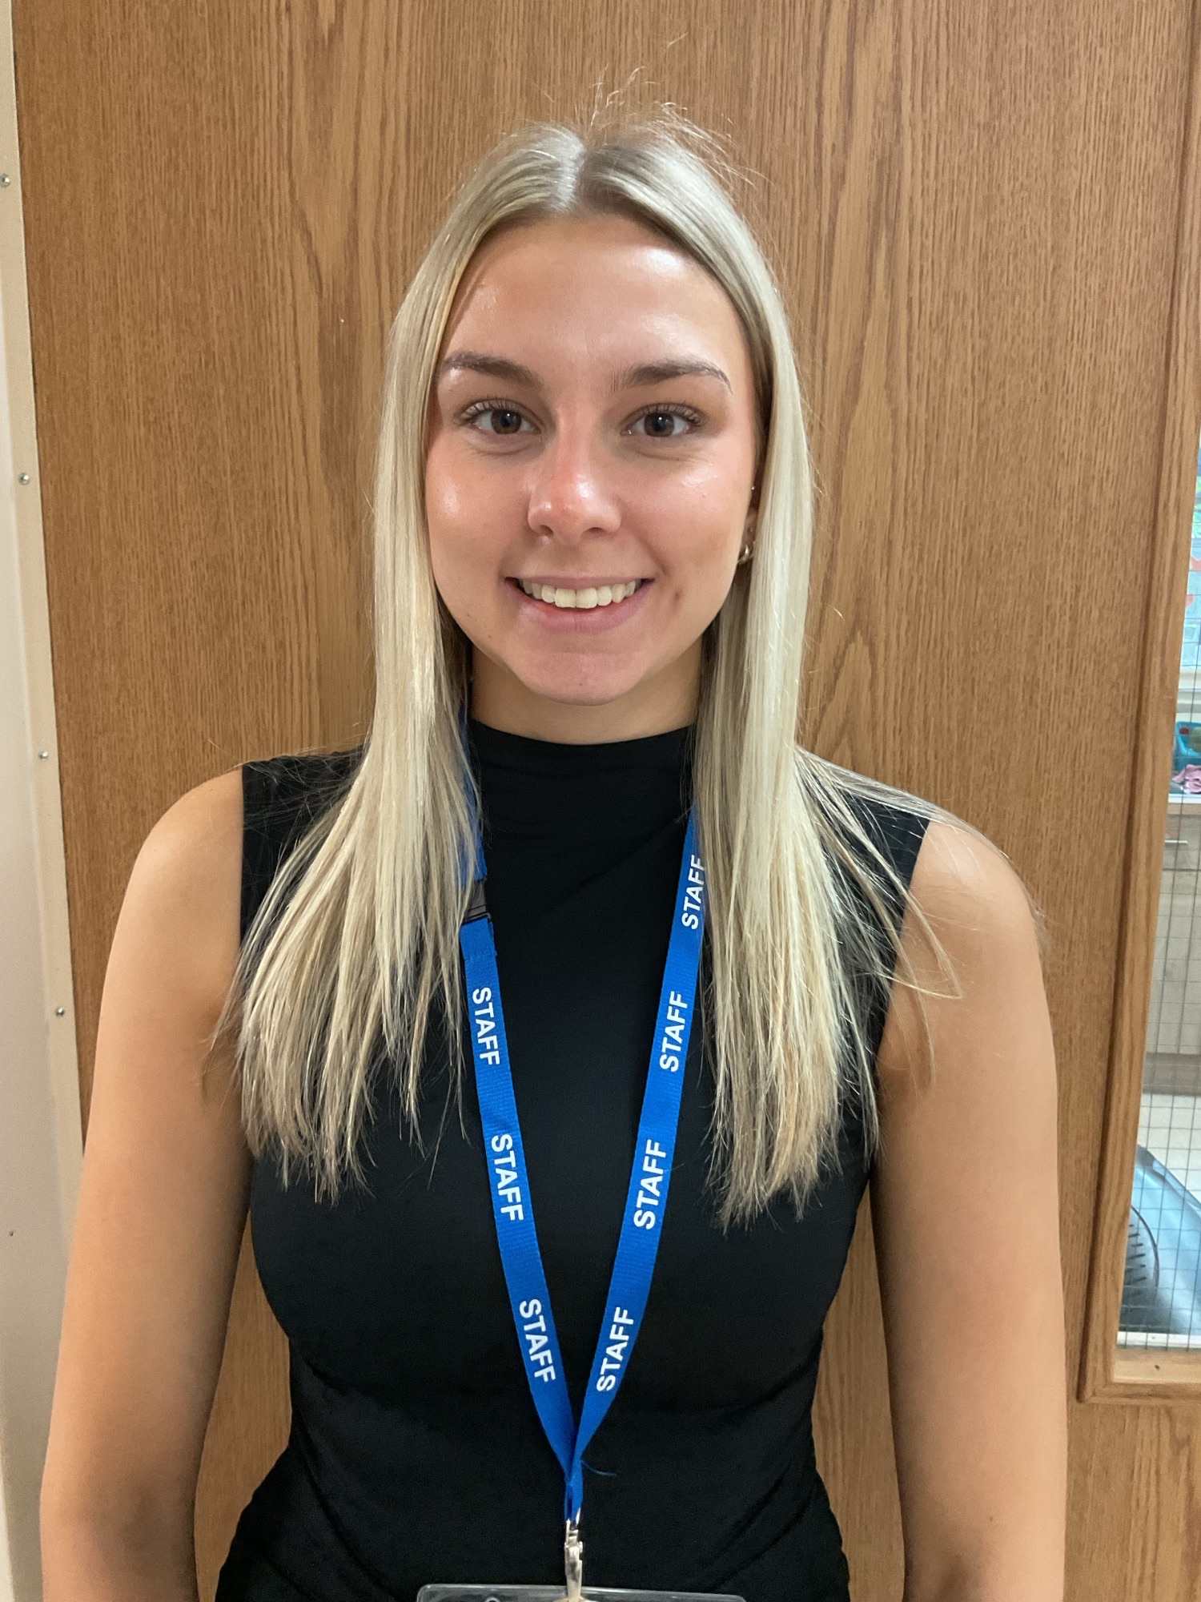
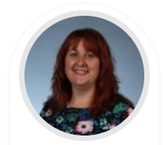
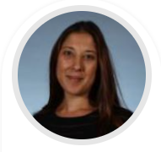
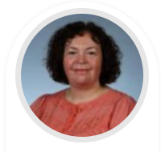

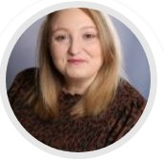
Meet the Team
Mrs S Jones
Reception Teacher
EYFS Lead
DSL
Miss S Huntington
Reception Teacher
Mrs J Webster
HLTA
Miss E Humphries
TA
Mrs C Jones
Nursery Teacher
Miss D Bowers
TA
Ms R Priest
Pastoral Lead/DSL

Slide 4
Attendance MATTERS
Excellent attendance at school allows a child to have the best possible start in life.
Illness
It can be tricky deciding whether to keep your child off school when they are unwell. Most illnesses are very mild, like a minor headache or a slight cold. If you decide to keep your child at home, it’s important to phone the school, or complete our online absence form before 9am to let us know why they will be absent. Parents need to call school every day of a child’s absence.
What should I do if my child is anxious or worried about going to school?
Sometimes, children and young people are anxious or worried about going to school. This could be because of reasons inside and outside school. You may feel, under these circumstances, it is best to allow your child to miss school. This will not help find a solution. If your child is worried about going to school, contact us to discuss the concern so it can be resolved.
Routine medical and dental appointments
Wherever possible, make medical and dental appointments after school or in school holidays.
What about taking my child out of school to go on holiday?
We will not authorise holidays taken during term time, unless there is an agreed exceptional circumstance. Should you wish to take your child out of school, then please complete a form which you can find in the waiting area.

Slide 5
Important: Attendance Notices
Penalty notices issued for offences are charged at a rate of £160 per parent per child. This can be paid at £80 if paid within 21 days.
Any second penalty notice issued to the same parent for the same child within a rolling 3-year period will be issued at the rate of £160 to be paid within 28 days with no option for a discounted rate.
The threshold at which a penalty notice must be considered is set at 10 sessions (equivalent to 5 days) of unauthorised absence within a rolling 10-school week period. This may include absences as a result of arriving late after the register closes at 9:15 am. The 10 school weeks may span different terms or school years.
A maximum of 2 penalty notices may be issued to a parent for the same child within a rolling 3-year period, so at the 3rd (or subsequent) offence(s) another course of action will need to be considered (such as prosecution).

Slide 6

Communication
It is good to talk!
Dropping off and Picking Up
Make an appointment via the office
Speak to the right person – class teacher first ☺
Our messages to you
Newsletters
Texts via School Spider
Parents' evening & Stay and Play sessions
Website
Parent Workshops
MOST IMPORTANTLY for Reception will be TAPESTRY!!!!!

Slide 7

SEND and Inclusion
Inclusion is at the heart of what we do. We make reasonable adjustments and provide tailored support so that every child can access learning, participate fully and feel that they belong.
Our approach is as follows:
Inclusive classrooms for all children
Adaptations made to teaching and learning approaches
Targeted support
Strong partnerships with families
Regular review and responsive provision
A whole-school commitment to belonging, progress and wellbeing
Currently, Mrs Grinsell is leading SEND in school with support from the SEND and Inclusion team. If you have any queries or concerns regarding additional needs, please email our new SEND inbox which will be checked every 2/3 days.
send@mount.dudley.sch.uk

Slide 8
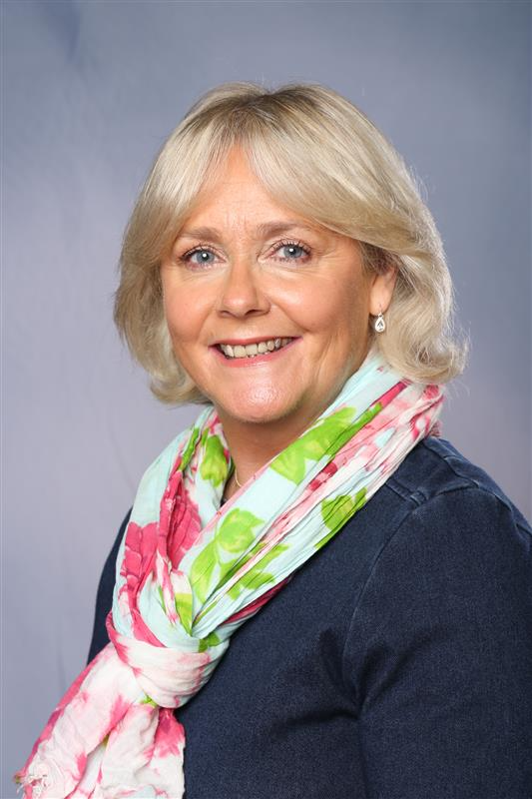

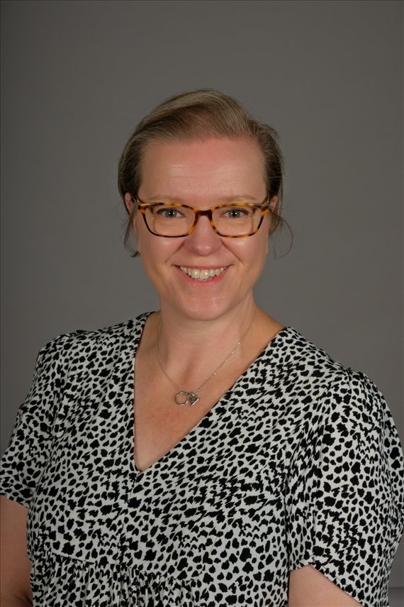
Safeguarding is at the heart of all we do
Safeguarding is everyone’s responsibility.
If you are concerned about a child or young person, please see a member of our Safeguarding Team or report it to Children’s Services 0300 555 0050 (9am – 5pm) or 0300 555 8574 (out of office hours) In an emergency dial 999
Mrs Grinsell Ms Priest Mrs Jones
Designated Safeguarding Lead Deputy Safeguarding Lead Deputy Safeguarding Lead

Slide 9
Our School Rules
Kind words
Kind actions

Slide 10

PE Days
Indoor - Monday
Outdoor - Wednesday
PE starts on 21st September
Please:
Label everything!
Work with your child to be able to put trainers/pumps, cardigans,
jumpers and socks on and take them off independently.

Slide 11

Reception Curriculum Enrichment 2026-27
 | VISITORS IN | VISITS IN THE LOCALITY | VISITS OUT OF THE LOCALITY
AUTUMN Let’s Explore Build it Up Sparkle & Shine | Stay & Play – wb 2.11.26 Flip the Clown Parent workshops: Phonics/reading – 8.10.26 Maths - tba Writing -tba Approx. £10 - Clown and Animal lady combined | Walk to the Postbox
SPRING Dangerous Dinosaurs Ready Steady Grow Signs of Spring | Class Assembly | Library Stevens Park
SUMMER Animal Safari Creep Crawl &Wriggle On the Beach Moving On | Animal Lady Stay & Play School Disco | Forest School | ThinkTank - £15.00 approx.

Slide 12
EYFS -Learning and Assessments
During the year, your child will continue to be learning through play and (when it is developmentally appropriate) will begin more formalised learning activities. They will work through Learning Adventures linked closely to their interests and books.
The children will begin Little Wandle phonics lessons and will be learning to read, write and develop their mathematical skills and knowledge as well as discovering their creative sides and finding out about their world and developing their fine and gross motor skills.
Mrs Grinsell and Miss Williams are beginning to complete the Reception Baseline with the children and during the Summer term the children will be informally assessed by the staff so that they can complete the Early Years Profile which gives a big picture of each child's achievements at the end of their Early Years journey. This then feeds into the information given to the Year 1 teachers so that they can ensure that they can support the children appropriately as they move into Key Stage 1.

Slide 13
School Dinners and Snacks
We have Coombs as our school lunch providers and we would ask that you encourage your child to have a school dinner every day. They are delicious!
Remember that each child from Reception to the end of Year 2 can have a Universal Free School Meal funded by the Government.
Please note that if your circumstances have changed since you completed the Free School Meal forms, please complete the link below or pop to the school office to get a form. Free school meals | Dudley Council
Snacks – the children are provided with fruit at snack time as we like to promote healthy eating and please remember we are a nut free school, so please do not send nuts or anything that may contain nuts (eg Nutella biscuits etc) in lunch boxes.

Slide 14
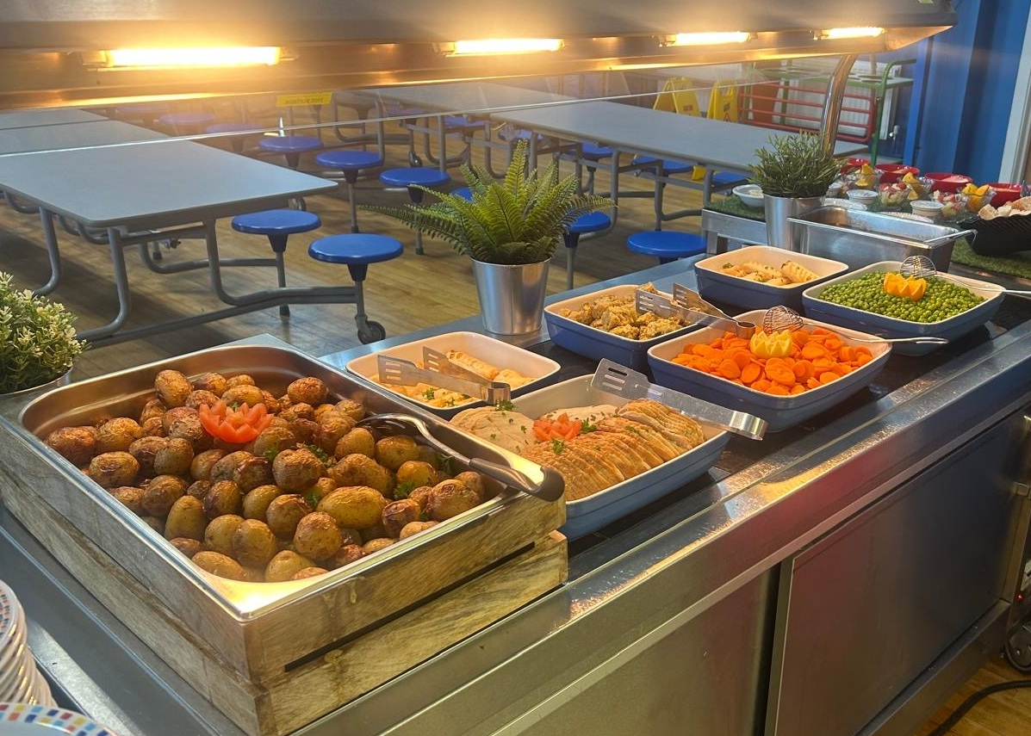
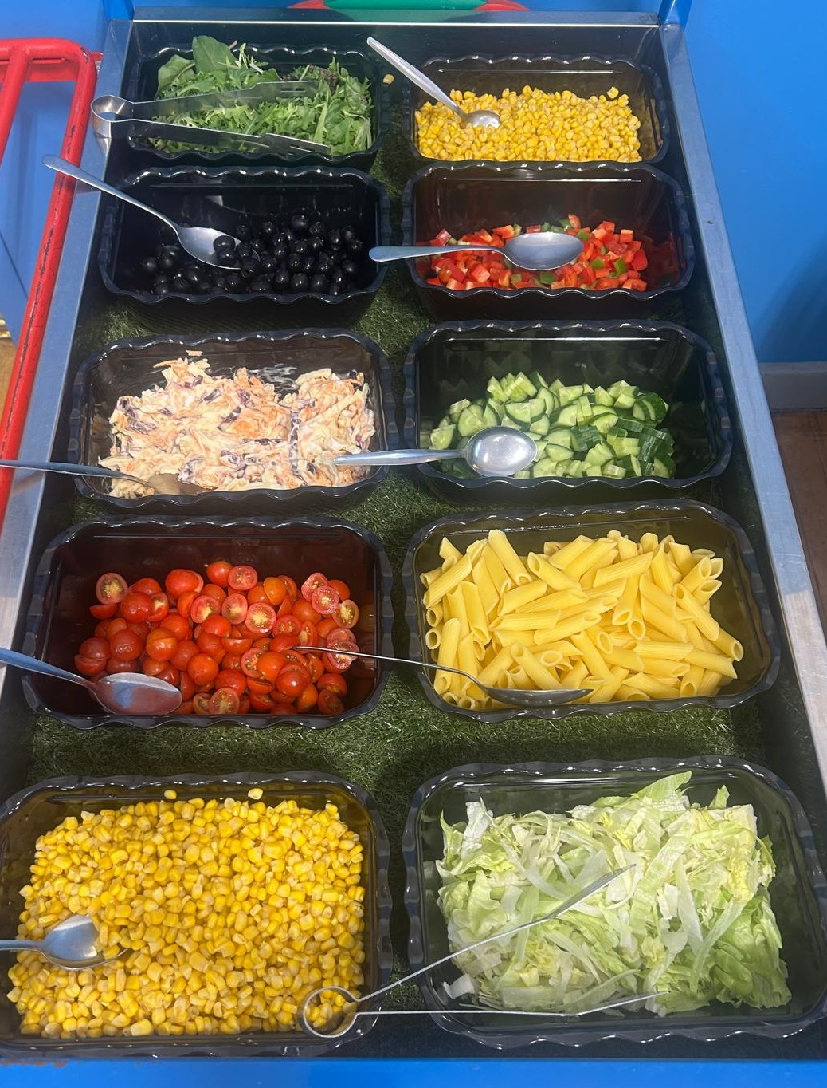
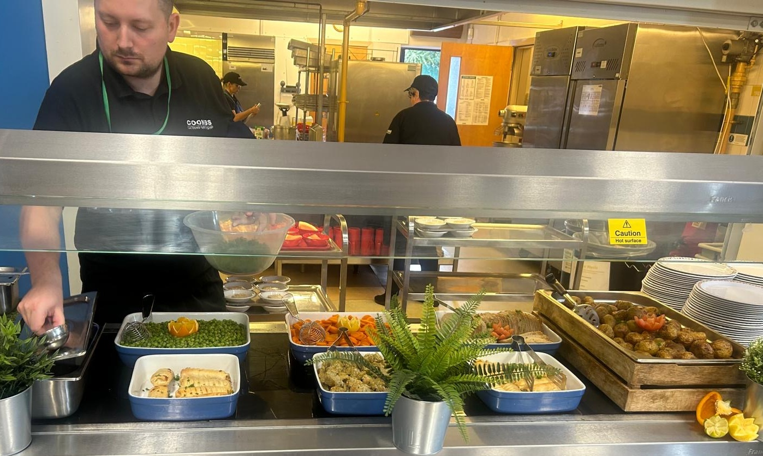
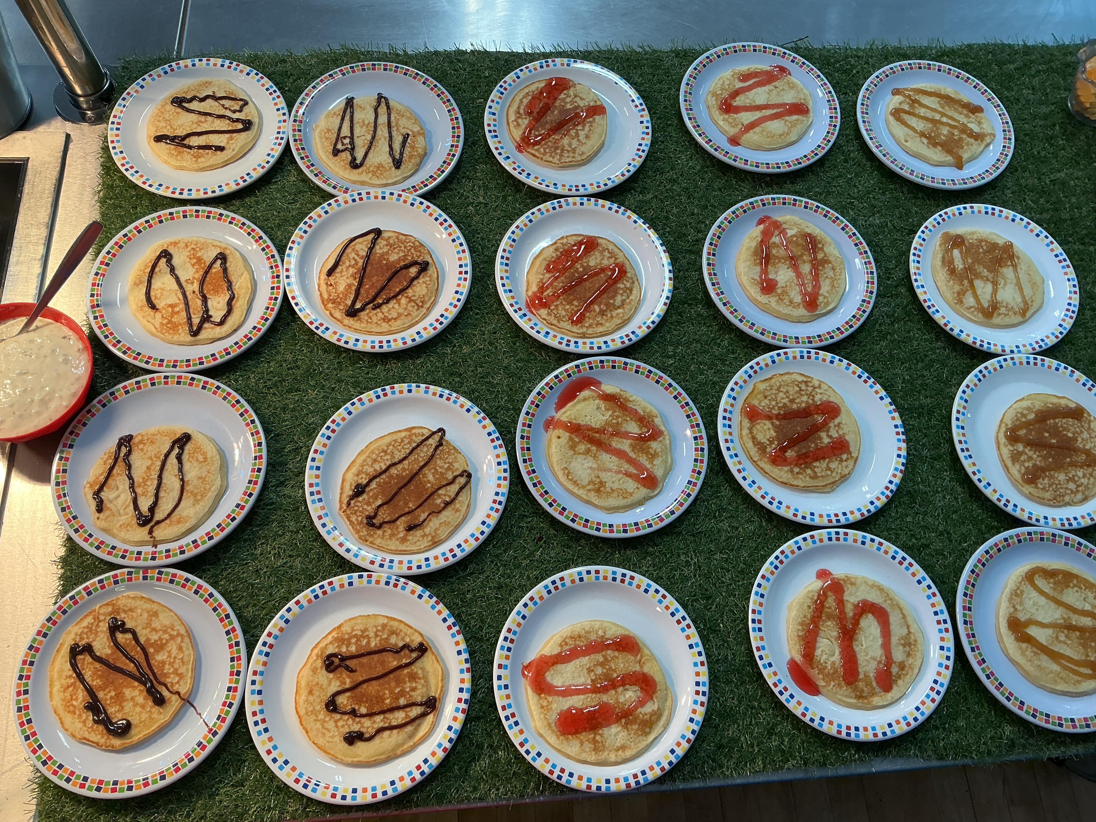
Luscious Lunches!

Slide 15



Slide 16
What we need from you...
Book bag (without keyrings)
Water bottle (filled everyday)
Named uniform
Named PE kit (to wear on PE days)
Please check Tapestry, School Spider and the website regularly – at least once a week.

Slide 17

We encourage you to send in a book
to celebrate your
child’s birthday, rather than sweets as:
Reading is our
SUPER POWER!

Slide 18
Thank you for coming, we look forward to working with you all.

